Slide 1
Mechanisms and Robotics DE / ES ZG561
Lecture - 6

Slide 2
Forward kinematics
3 dof Cylindrical Arm
3 dof Articulated Arm
5 dof Articulated Arm

Slide 3
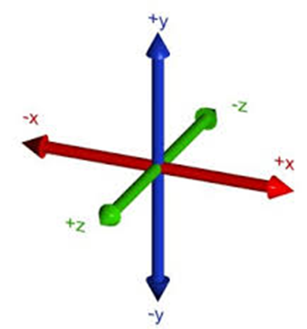
Coordinate Systems
Directions of Positive X Y Z axes

Slide 4
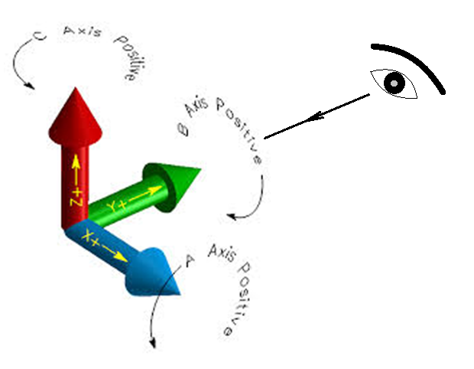
Coordinate Systems
Directions of Positive X Y Z rotations
Anticlockwise rotation is positive when seen from the opposite direction of the arrow head

Slide 5
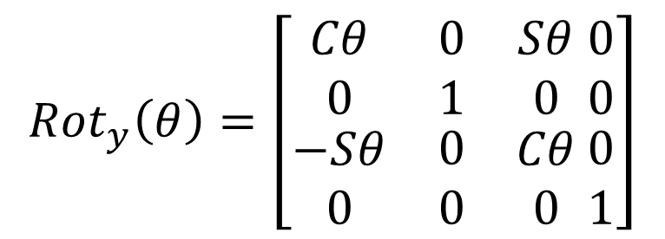
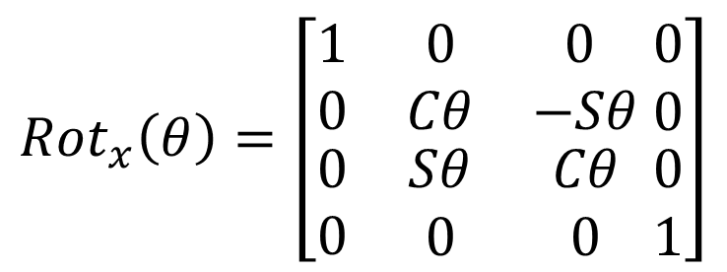

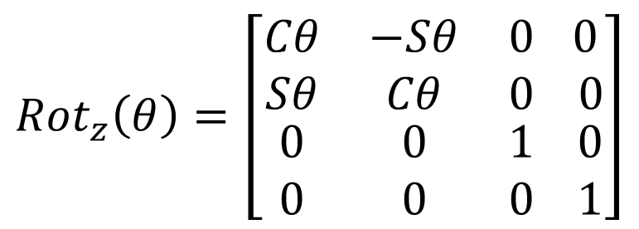
Homogeneous Transformation Matrices
When we want to describe a generalized transformation by a single matrix that combines the effects of translation and rotation, we define a vector by adding 1.
$$V=\left[ \begin{matrix}x \\ y \\ \begin{matrix}z \\ 1\end{matrix}\end{matrix}\right]$$
$${Rot}_{x}\left(θ\right)=\left[\begin{matrix}1 & 0 & 0 \\ 0 & Cθ & −Sθ \\ \begin{matrix}0 \\ 0\end{matrix} & \begin{matrix}Sθ \\ 0\end{matrix} & \begin{matrix}Cθ \\ 0\end{matrix}\end{matrix} \begin{matrix}0 \\ 0 \\ \begin{matrix}0 \\ 1\end{matrix}\end{matrix}\right]$$
$${Rot}_{z}\left(θ\right)=\left[\begin{matrix}Cθ & −Sθ & 0 \\ Sθ & Cθ & 0 \\ \begin{matrix}0 \\ 0\end{matrix} & \begin{matrix}0 \\ 0\end{matrix} & \begin{matrix}1 \\ 0\end{matrix}\end{matrix} \begin{matrix} 0 \\ 0 \\ \begin{matrix}0 \\ 1\end{matrix}\end{matrix}\right]$$
$${Rot}_{y}\left(θ\right)=\left[\begin{matrix}Cθ & 0 & Sθ \\ 0 & 1 & 0 \\ \begin{matrix}−Sθ \\ 0\end{matrix} & \begin{matrix}0 \\ 0\end{matrix} & \begin{matrix}Cθ \\ 0\end{matrix}\end{matrix} \begin{matrix}0 \\ 0 \\ \begin{matrix}0 \\ 1\end{matrix}\end{matrix}\right]$$

Slide 6
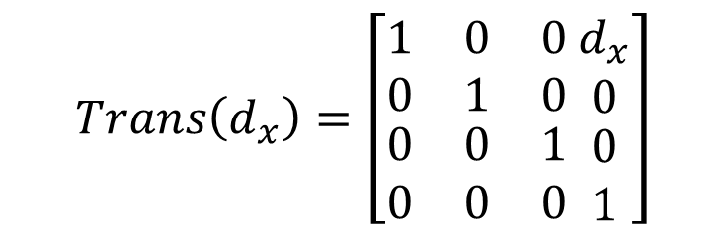
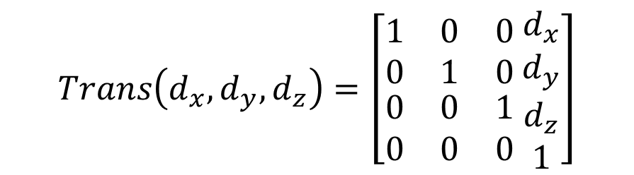
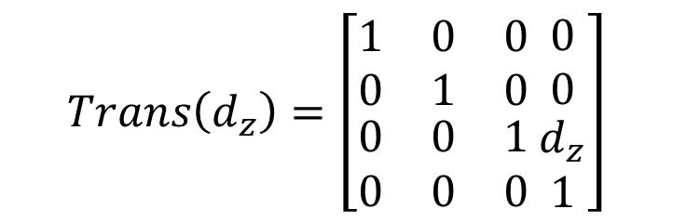
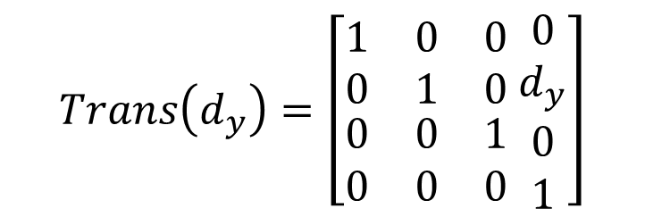
Homogeneous Transformation Matrices
$$Trans\left(d_{x},d_{y},d_{z}\right)=\left[\begin{matrix}1 & 0 & 0 \\ 0 & 1 & 0 \\ \begin{matrix}0 \\ 0\end{matrix} & \begin{matrix}0 \\ 0\end{matrix} & \begin{matrix}1 \\ 0\end{matrix}\end{matrix} \begin{matrix}d_{x} \\ d_{y} \\ \begin{matrix}d_{z} \\ 1\end{matrix}\end{matrix}\right]$$
$$Trans\left(d_{x}\right)=\left[\begin{matrix}1 & 0 & 0 \\ 0 & 1 & 0 \\ \begin{matrix}0 \\ 0\end{matrix} & \begin{matrix}0 \\ 0\end{matrix} & \begin{matrix}1 \\ 0\end{matrix}\end{matrix} \begin{matrix}d_{x} \\ 0 \\ \begin{matrix}0 \\ 1\end{matrix}\end{matrix}\right]$$
$$Trans\left(d_{z}\right)=\left[\begin{matrix}1 & 0 & 0 \\ 0 & 1 & 0 \\ \begin{matrix}0 \\ 0\end{matrix} & \begin{matrix}0 \\ 0\end{matrix} & \begin{matrix}1 \\ 0\end{matrix}\end{matrix} \begin{matrix}0 \\ 0 \\ \begin{matrix}d_{z} \\ 1\end{matrix}\end{matrix}\right]$$
$$Trans\left(d_{y}\right)=\left[\begin{matrix}1 & 0 & 0 \\ 0 & 1 & 0 \\ \begin{matrix}0 \\ 0\end{matrix} & \begin{matrix}0 \\ 0\end{matrix} & \begin{matrix}1 \\ 0\end{matrix}\end{matrix} \begin{matrix}0 \\ d_{y} \\ \begin{matrix}0 \\ 1\end{matrix}\end{matrix}\right]$$

Slide 7
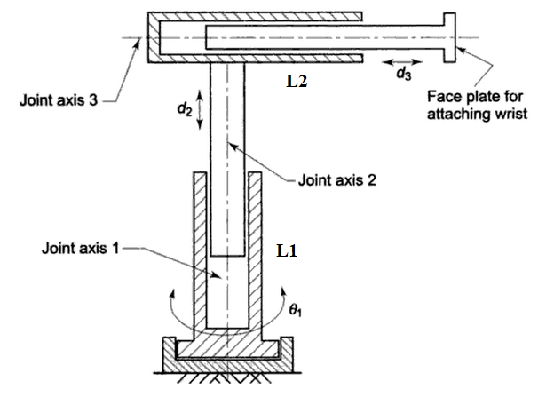
Cylindrical arm – Forward Kinematics

Slide 8
Cylindrical arm – Forward Kinematics

Slide 9
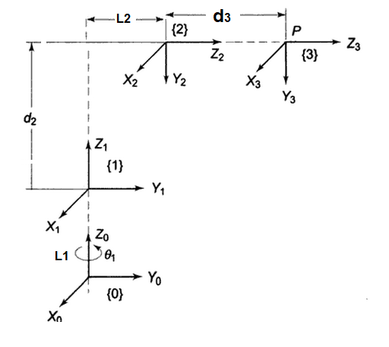
Link Coordinate Diagram

Slide 10
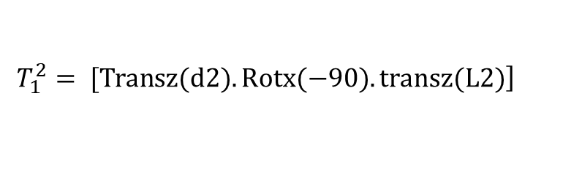
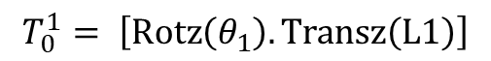
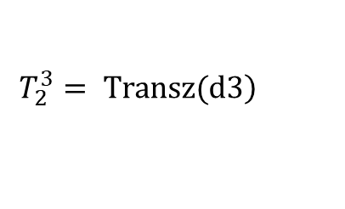
D-H Parameters
Solution:
[x’,y’,z’] = [Rotz(θ1).Transz(L1)].[Transz(d2).Rotx(-90).transz(L2)].Transz(d3).[0,0,0]’
$$T_{0}^{1}= \left[Rotz\left(θ_{1}\right).Transz\left(L1\right)\right]$$
$$\left.T_{1}^{2}= [Transz(d2).Rotx(−90).transz(L2)\right]$$
$$\left.T_{2}^{3}= Transz(d3\right)$$
D-H Parameters
Link i | θ | d | α | a | Home
1 | θ1 | L1
2 |  | d2, L2 | -90
3 |  | d3

Slide 11
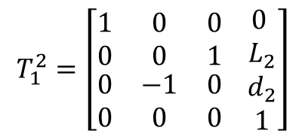
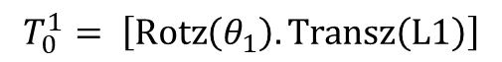
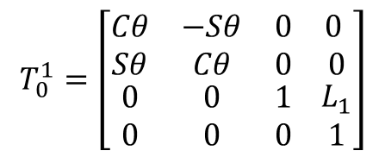
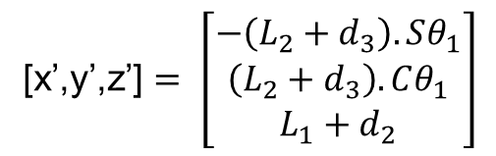
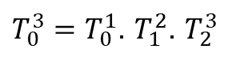
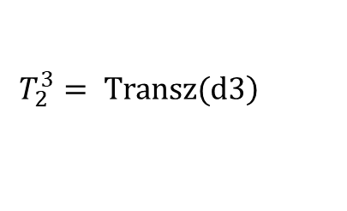
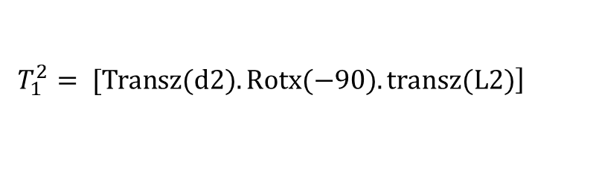
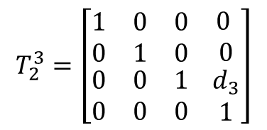
D-H Parameters
Solution:
Solution: [x’,y’,z’] = [Rotz(θ1).Transz(L1)].[Transz(d2).Rotx(-90).transz(L2)].
Transz(d3).[0,0,0]’
$$T_{0}^{1}=\left[\begin{matrix}Cθ & −Sθ & 0 \\ Sθ & Cθ & 0 \\ \begin{matrix}0 \\ 0\end{matrix} & \begin{matrix}0 \\ 0\end{matrix} & \begin{matrix}1 \\ 0\end{matrix}\end{matrix} \begin{matrix} 0 \\ 0 \\ \begin{matrix}L_{1} \\ 1\end{matrix}\end{matrix}\right]$$
$$T_{0}^{1}= \left[Rotz\left(θ_{1}\right).Transz\left(L1\right)\right]$$
$$\left.T_{1}^{2}= [Transz(d2).Rotx(−90).transz(L2)\right]$$
$$\left.T_{2}^{3}= Transz(d3\right)$$
$$T_{1}^{2}=\left[\begin{matrix}1 & 0 & 0 \\ 0 & 0 & 1 \\ \begin{matrix}0 \\ 0\end{matrix} & \begin{matrix}−1 \\ 0\end{matrix} & \begin{matrix}0 \\ 0\end{matrix}\end{matrix} \begin{matrix} 0 \\ L_{2} \\ \begin{matrix}d_{2} \\ 1\end{matrix}\end{matrix}\right]$$
$T_{0}^{3}=T_{0}^{1}$. $T_{1}^{2}$. $T_{2}^{3}$
$$T_{2}^{3}=\left[\begin{matrix}1 & 0 & 0 \\ 0 & 1 & 0 \\ \begin{matrix}0 \\ 0\end{matrix} & \begin{matrix}0 \\ 0\end{matrix} & \begin{matrix}1 \\ 0\end{matrix}\end{matrix} \begin{matrix} 0 \\ 0 \\ \begin{matrix}d_{3} \\ 1\end{matrix}\end{matrix}\right]$$
[x’,y’,z’] $= \left[\begin{matrix}−\left(L_{2}+d_{3}\right).Sθ_{1} \\ \left(L_{2}+d_{3}\right).Cθ_{1} \\ L_{1}+d_{2}\end{matrix}\right]$

Slide 12
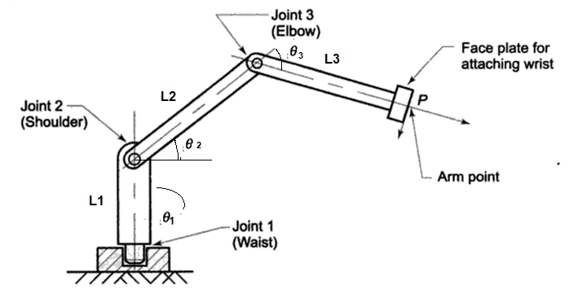
3 dof Articulated Robot – Forward Kinematics

Slide 13
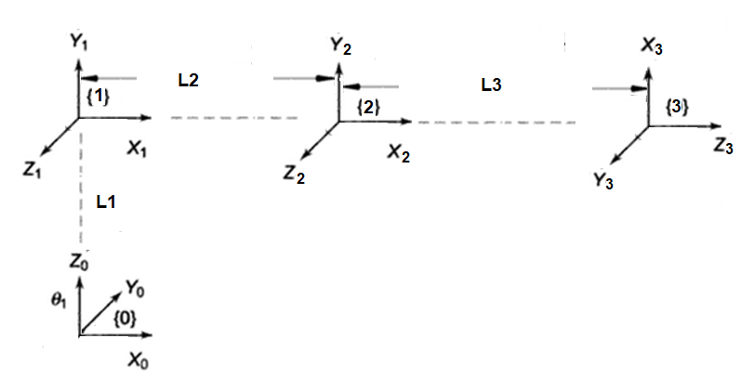
3 dof Articulated Robot – Link Coordinate Diagram

Slide 14
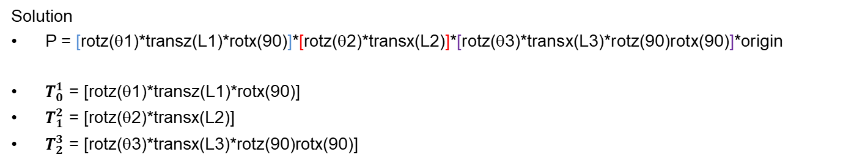
3 dof Articulated Robot – Forward Kinematics
3 dof Articulated manipulator
Solution
P = [rotz(θ1)*transz(L1)*rotx(90)]*[rotz(θ2)*transx(L2)]*[rotz(θ3)*transx(L3)*rotz(90)rotx(90)]*origin
$T_{0}^{1}$ = [rotz(θ1)*transz(L1)*rotx(90)]
$T_{1}^{2}$ = [rotz(θ2)*transx(L2)]
$T_{2}^{3}$ = [rotz(θ3)*transx(L3)*rotz(90)rotx(90)]
Link i | θ | d | α | a | Home
1 | θ1 | L1 | 90
2 | θ2 |  |  | L2
3 | θ3 |  | 90 | L3 | 90

Slide 15
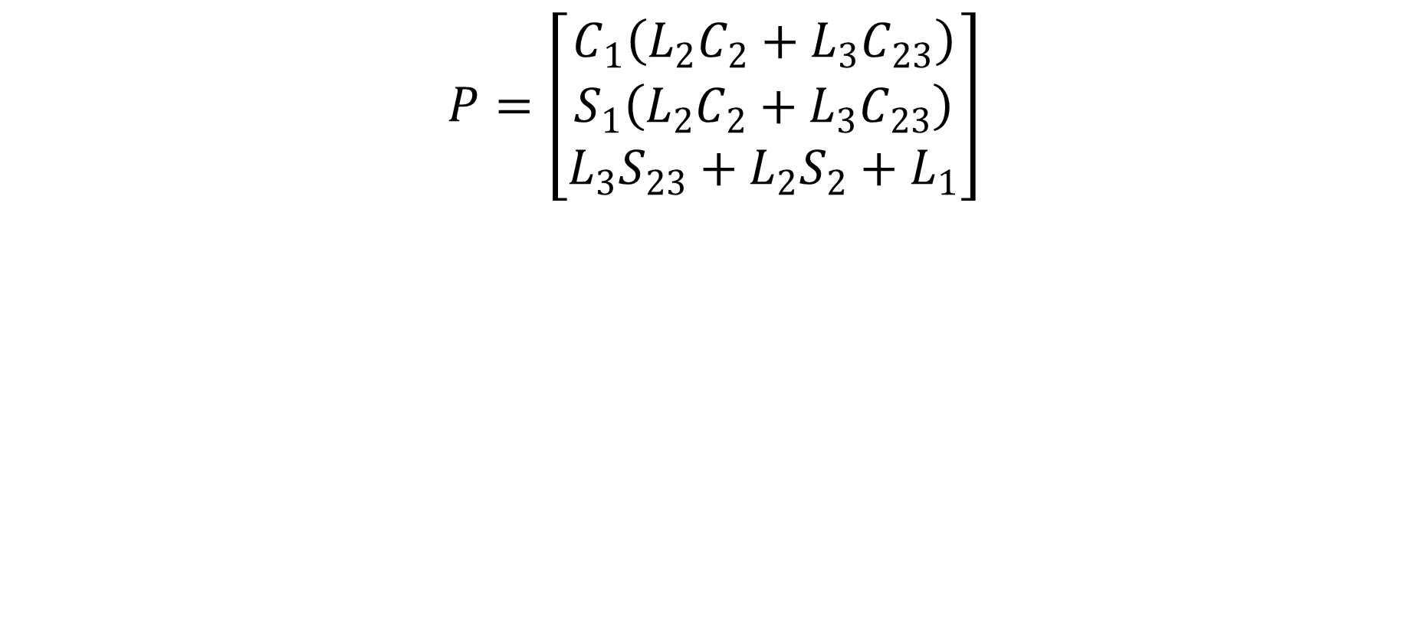
3 dof Articulated Robot – Forward Kinematics
$$P=\left[\begin{matrix}C_{1}\left(L_{2}C_{2}+L_{3}C_{23}\right) \\ S_{1}\left(L_{2}C_{2}+L_{3}C_{23}\right) \\ L_{3}S_{23}+L_{2}S_{2}+L_{1}\end{matrix}\right]$$

Slide 16
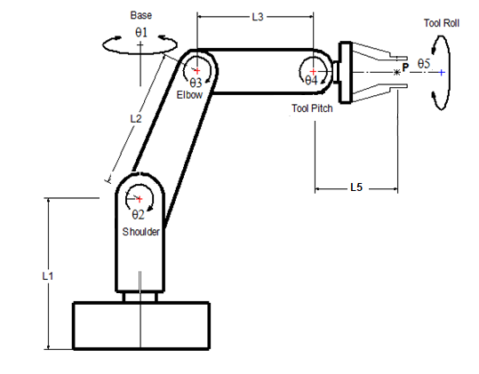
5 dof manipulator
L1 = 200mm, L2 = 250mm, L3 = 300mm, L4 = 150mm,

Slide 17
5 dof manipulator
Solution:
P = [rotz(theta1)*transz(L1)*rotx(90)]*[rotz(theta2)*transx(L2)]*[rotz(theta3)*transx(L3)]*[rotz(theta4)*rotz(90)*rotx(90)]*[rotz(theta5)*transz(L5)]*origin

Slide 18
5 dof manipulator
P = [rotz(theta1)*transz(L1)*rotx(90)]*[rotz(theta2)*transx(L2)]*[rotz(theta3)*transx(L3)]*[rotz(theta4)*rotz(90)*rotx(90)]*[rotz(theta5)*transz(L4)]*origin
Axis | θ | d | a | α | Home
1 | θ1 | L1 |  | 90
2 | θ2 |  | L2
3 | θ3 |  | L3
4 | θ4 |  |  | 90 | 90
5 | θ5 | L5

Slide 19
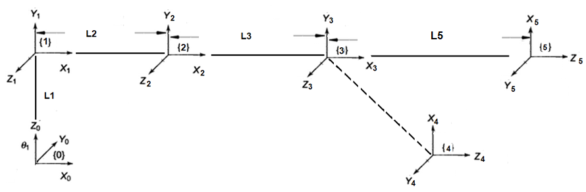
5 dof manipulator

Slide 20
5 dof manipulator
P = [rotz(theta1)*transz(L1)*rotx(90)]*[rotz(theta2)*transx(L2)]*[rotz(theta3)*
transx(L3)]*[rotz(theta4)*rotz(90)*rotx(90)]*[rotz(theta5)*transz(L5)]*origin

Slide 21
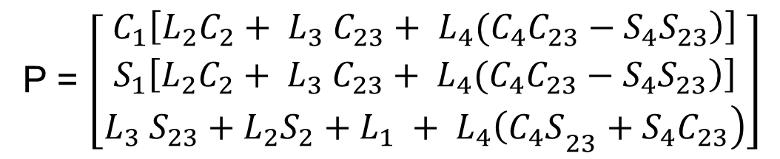
5 dof manipulator
P = $\left[\begin{matrix}C_{1}\left[\left.L_{2}C_{2}+ L_{3} C_{23}+ L_{4}(C_{4}C_{23}−S_{4}S_{23}\right)\right] \\ S_{1}\left[\left.L_{2}C_{2}+ L_{3} C_{23}+ L_{4}(C_{4}C_{23}−S_{4}S_{23}\right)\right] \\ \left.{L_{3} S_{23}+L_{2}S_{2}+L}_{1} + L_{4}{\left(C_{4}S\right.}_{23}+{S_{4}C}_{23}\right)\end{matrix}\right]$

Slide 22
THANK YOU
The presenter is grateful to the authors of the following text books for their wonderful work.
Industrial Robotics Computer Interfacing and Control – Wesley E. Snyder
Fundamentals of Robotics – Robert Schilling

